Slide 1


停车场管理
演讲者 沈公子

Slide 2




章节
壹
贰
叁
肆
系统功能项
车辆出队列与等待中的车辆进入队列
结构体
查询车辆

Slide 3

结构体

Slide 4

/**时间*/
typedef struct time
{
int hour;
int min;
} Time;
/**车辆信息*/
typedef struct node
{
char car_num[10];
Time inTime;
Time outTime;
} CarNode;
/**停车场内车辆信息*/
typedef struct node2
{
CarNode * stack[MAXNUM +1];
int top;
} SeqStackCar;
typedef struct car
{
CarNode * data; //车辆信息
struct car * next;
//指向下一个的指针域
} QueueNode;
typedef struct Node
{
QueueNode * head;//头车
QueueNode * rear;//尾车
} LinkQueueCar;

Slide 5




查询车辆
天天开心
该程序应用栈来完成的车辆进停车场和出停车场就是一个数据进栈和出栈的过程。如果停车场（栈）满了，就将车辆放在便道（队列）里；在车辆离开时计算出使用费用，并将便道第一辆车停到该车位置。

Slide 6

int findCarInfo(SeqStackCar *enter,LinkQueueCar * wite)
{
cout<<"\n\t请输入要搜索的车牌号：";
char findcarnum [10];
cin>>findcarnum;
for(int i= 1 ; i <= enter->top ; i++)
{
int result = strcmp(findcarnum,enter->stack[i]->car_num);
if (result==0)
{
cout<<"\n\t在场内找到车辆"<<findcarnum<<endl;
cout<<"\n\t入场时间:"<<enter->stack[i]->inTime.hour<<"时"<<enter->stack[i]->inTime.min<<"分\n";
return OK;
}
}
if ((wite->head!=wite->rear))
{

Slide 7

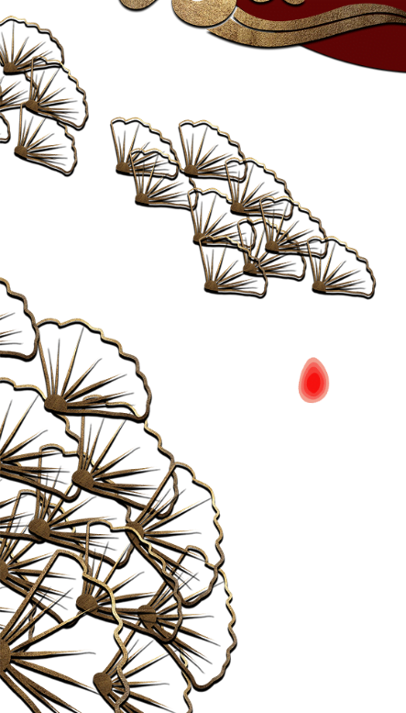
CarNode *t;
QueueNode * q = wite->head->next ;
int i =1;
while (q!=NULL)
{
t = q->data;
int result = strcmp(findcarnum,t->car_num);
if(result==0)
{
cout<<"\n\t在等待队列中找到车辆"<<findcarnum<<endl;
return OK;
}
q = q -> next;
i++;
}
}
cout<<"\n\t查找完成未找到"<<findcarnum<<endl;
return ERROR;
}

Slide 8
系统功能项

Slide 9
switch(choose)
{
/** 1.停车场停车信息显示*/
case 1:
showinPark(&enter);
break;
/**2.等待中停车信息显示 */
case 2:
showWaitCar(&wait);
break;
/**3.汽车到达停车场操作*/
case 3:
Arrival(&enter,&wait);
break;
/**4.汽车离去停车场操作*/
case 4:
Leave(&enter,&temp,&wait);
break;
/**5.查找汽车功能 */
case 5:
findCarInfo(&enter,&wait);
break;
PPT模板 http://www.1ppt.com/moban/

Slide 10

/**6.清屏 */
case 6:
system("cls");
break;
/**7.退出系统 */
case 7:
exit(0);
break;
default:
break;
}

Slide 11

if (enter ->top<MAXNUM)
{
enter ->top++;
cout<<"\n\t车辆在停车场第"<<enter->top<<"位置\n";
GetLocalTime( &sys );
cout<<"\n\t到达时间为："<<sys.wHour<<":"<<sys.wMinute<<endl;
p->inTime.hour = sys.wHour;
p->inTime.min = sys.wMinute;
enter->stack[enter->top] = p;
return OK;
}

Slide 12


else
{
cout<<"\n\t车场已满需要等待!\n";
t = (QueueNode *) malloc(sizeof(QueueNode));
t->data = p;
t->next = NULL;
q->rear->next =t;
q->rear = t;
return OK;
}

Slide 13
车辆出队列与等待中的车辆进入队列

Slide 14



if (enter ->top>0)
{
while(true)
{
cout<<"\n\t请输入车在车场的位置/1--"<<enter->top<<"/";
cin>>room;
if(room>=1&&room<=enter->top)
{
break;
}
}
while(enter->top>room)
{
temp ->top++;
temp->stack[temp->top] = enter->stack[enter->top];
enter->stack[enter->top]=NULL;
enter->top--;
}
p=enter->stack [enter->top];
enter ->stack[enter->top] = NULL;
enter->top--;
while(temp->top >= 1)
{
enter->top++;
enter->stack[enter->top] = temp->stack[temp->top];
enter->stack[temp->top]= NULL;
temp->top--;
华而不实

Slide 15

}
Print(p,room);
if ((wite->head!=wite->rear)&&enter->top<MAXNUM)
{
q= wite->head ->next;
t = q->data;
enter ->top++;
cout<<"\n\t等待的"<<(t->car_num)<<"车进入车场第"<<(enter->top)<<"位置\n";
GetLocalTime( &sys );
cout<<"\n\t入场时间为："<<sys.wHour<<":"<<sys.wMinute<<endl;
p->inTime.hour = sys.wHour;
p->inTime.min = sys.wMinute;
wite ->head ->next = q->next;
if (q==wite->rear)
{
wite ->rear = wite->head;
}
enter->stack[enter->top] = t;
free(q);
}
else
{
cout<<"\n没有等待中的车辆\n";
}
}
else
{
cout<<"\n\t停车场里没有车\n";
}

Slide 16

bool matchCarNum(char * incar)
{
string firstlocation = "京津沪渝冀豫云辽黑湘皖鲁新苏浙赣鄂桂甘晋蒙陕吉闽贵粤青藏川宁琼使领";
string regional = "QWERTYUIOPASDFGHJKLZXCVBNM";
string a = incar;
if (firstlocation.find(a.substr(0,2))<=firstlocation.length()
&&regional.find(incar[2])<=firstlocation.length())
{
return true;
}
else
{
cout<<"\t车牌号错误"<<endl;
return false;
}
}

Slide 17
新年快乐
新年快乐
天天开心
心想事成
不挂科！

